Slide 1
WorldWay Logistic & Trade KFT
Company Presentation

Slide 2
This presentation will give you a brief overview of who we are, what we do, and how we can provide solutions to help you grow your business and manage your supply chain. Thank you for taking the time to view this presentation.
Thank you for taking the time to view this presentation.

Slide 3
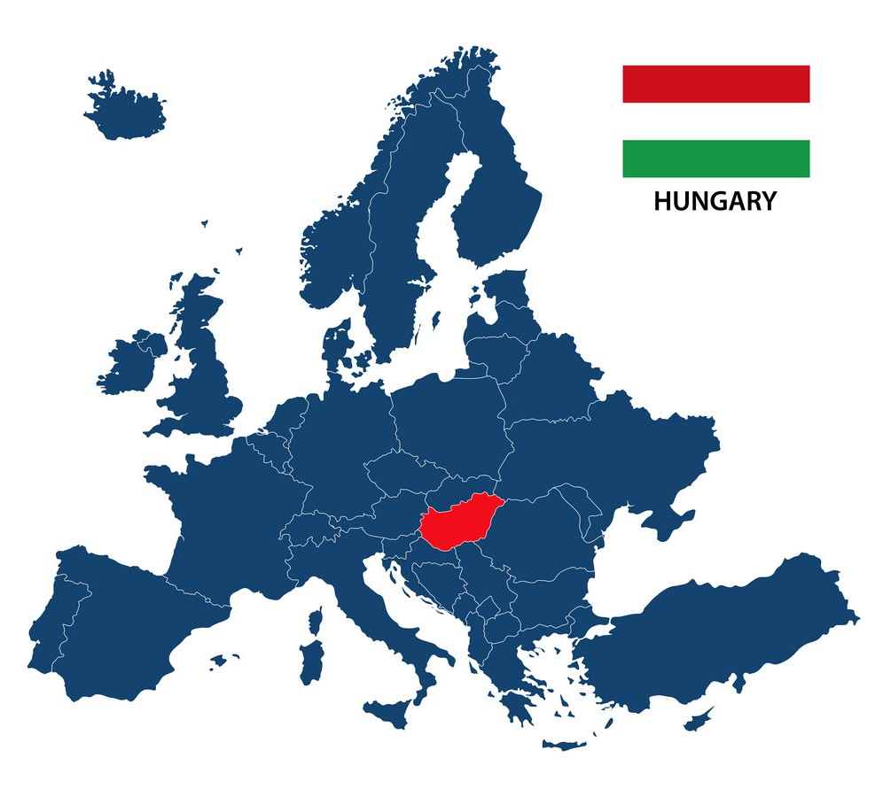
WorldWay Logistic & Trade KFT established in Budapest,Hungary and currently has a strategic partners in major sea&air ports across the World. We are specialize in sea&air freight,transport&Logistics , warehousing custom clearance.
Delivery is our core business but we compose solutions and long-term satisfaction .

Slide 4
We stand for: Customer-centric service Quality Responsibility Fairness Integrity Teamwork

Slide 5
Our mission
To deliver tailored ,reliable and productive solutions by land,sea ,air and railway and become part of unique part of supple-chain for our customers in fact for partners .
Our vision
We aim to be recognized as the most responsible and reliable all-round supplier of logistics services and transports in the countries where work.

Slide 6
We offer Services
Air freight forwarding
Ocean freight forwarding
Railway freight & forwarding
Custom clearance and Warehousing
Project / Special Cargo
Logistics
Land transportation & Road freight

Slide 7
Land transportation&Road freight
Inbound transport service
Outbound transport service
FTL/LTL Services
Reverse logistics
Insurance and additional services
Refrigerated, flatbed, COFC

Slide 8
Flexible, timely flight schedules
Extensive global partner networks
IATA approved partners
Dedicated transportation & door to door delivery
Cargo Security Management &Transportation quality
Air freight forwarding
Perishable, temperature-controlled, sensitive goods shipment

Slide 9
Ocean freight forwarding
FCL/LCL services
Special, dangerous, hazardous container shipment
Break bulk shipment
Extensive global networks
Containe stuffing, unloading and securing
Roll-on/Roll-of shippment

Slide 10
Railway freight forwarding
Break- bulk commodity shipment
Intermodal container shipment
Transshipment
International and local railway freight services
Additional support services

Slide 11
Custom clearance & warehousing
Assistance of custom clearance process
Consultation on local custom code
Storage including value added services
Picking & Packing
Insurance

Slide 12
Project/Special Cargo Logistics
Breakbulk
Solutions for cargo any size
OOG Container
Temperature & Humidity controlled shipments
Large-scale manufacturing, equipment, medicine and food carriage

Slide 13
Trade
Searching real buyers for goods, negotiating with customers in contract preparation, delivery process
Investigation of goods delivery conditions, time etc. for special goods
Investigation for special documentation, permission of goods
Investigation of export, custom process and certification requirements of goods
Investigation of import, custom process and certification requirements of goods

Slide 14
Contact us
Address: 1011 Budapest, Szilágyi Dezső tér 1. Neuschloss Palace. 2. em.
Email: info@worldway.hu
Phone: +36 70 658 89 33

